Slide 1
Chapter 14
Boxes, borders, padding, margins

Slide 2
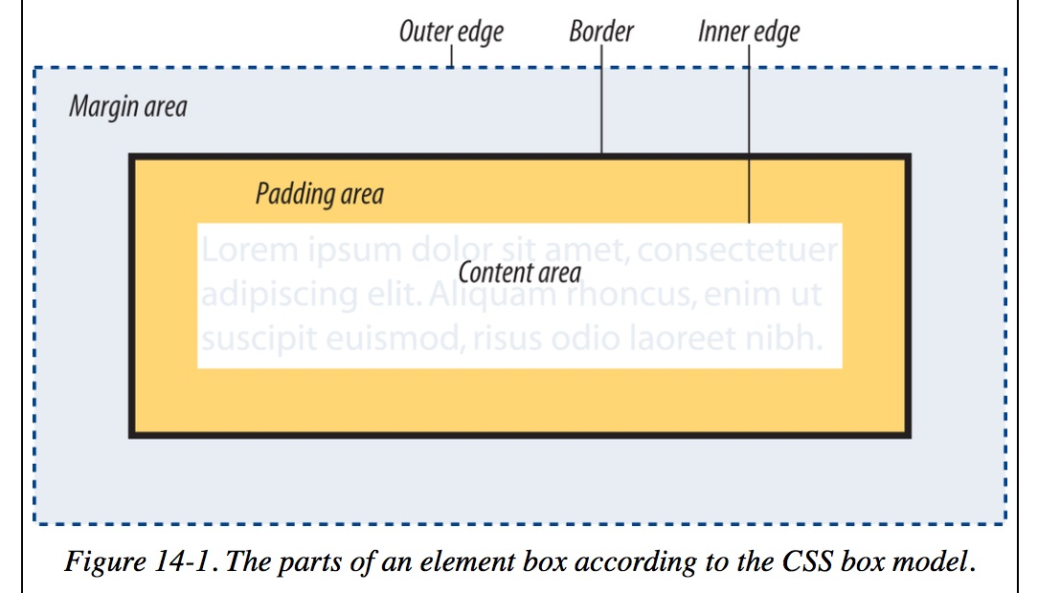
The Element Box

Slide 3
What Are the Parts of the Box?
Inner edges – edges of the content area
Padding – area between content area and border
Margins – always transparent, allowing background of parent element to show through
Outer edge – invisible

Slide 4
Sizing the Box
p {
background: #c2f670;
width: 500px;
height: 150px;
padding: 20px;
border: 2px solid gray;
margin: 20px;
}
Notes:
a simple box is given a width of 500 pixels, a height of 150 pixels, with 20 pixels of padding, a 2-pixel border, and a 20-pixel margin all around. Using the content box model, the width and height values are applied to the content area only.

Slide 5
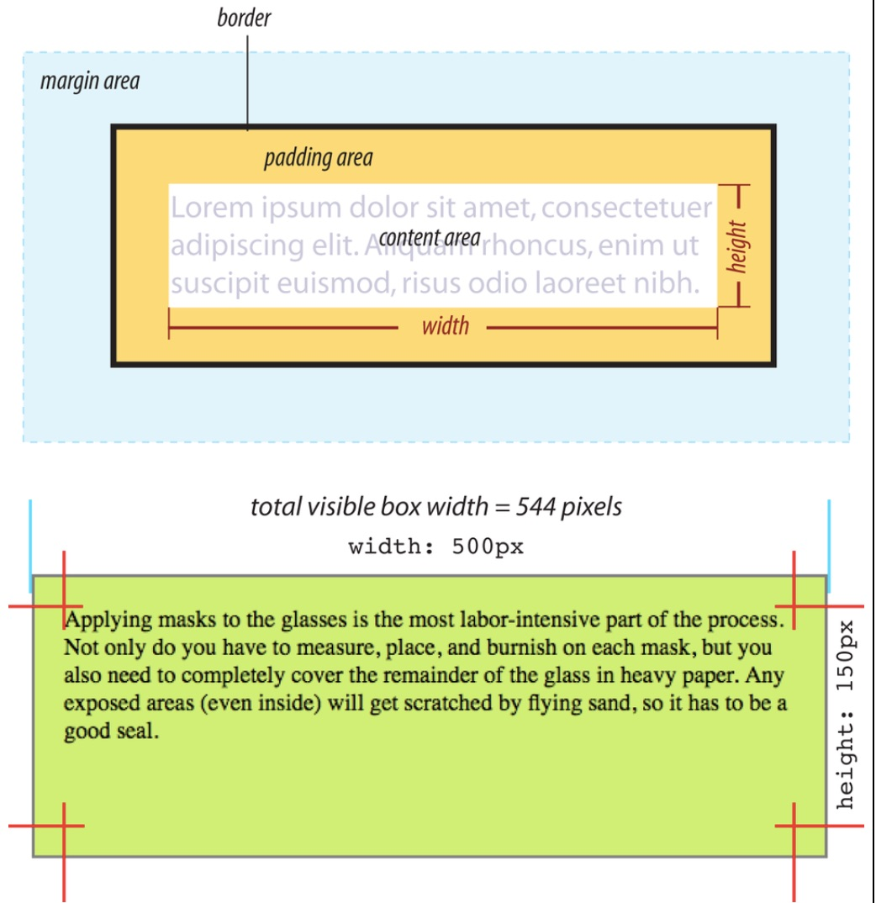

Slide 6
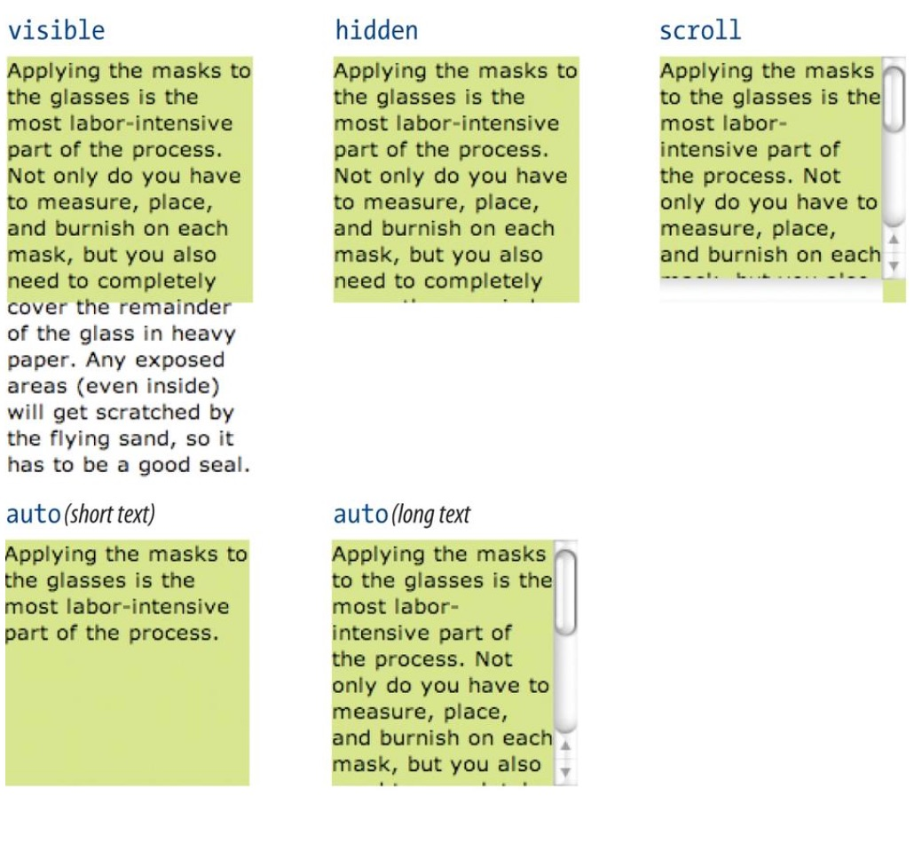
Handling Overflow
Overflow attribute is used to specify what to do when an element is set to a size that is too small for its contents

Slide 7
Padding
Used to specify space around the content area
Set each individually, or all at once
padding: 1em, 2em, 1em, 2em (TRBL)

Slide 8
Border Properties
border-style
border-width
border-color
border-radius (used to set rounded corners)
border-image (used to specify an image as a border)
Notes:
problem at end of chapter 14 (fig. 14-24)

